Slide 1
Your Child Has Been Diagnosed With PKD – Now What? Lisa M. Guay-Woodford, MD Children’s Hospital of Philadelphia

Slide 2
Activity Disclaimer
The material presented here is being made available by the Polycystic Kidney Disease Foundation (PKDF) for educational purposes only. This material is not intended to represent the only, nor necessarily best, methods or procedures appropriate for the medical situations discussed. Rather, it is intended to present an approach, view, statement, or opinion of the faculty, which may be helpful to others who face similar situations.
The PKDF disclaims any and all liability for injury or other damages resulting to any individual using this material and for all claims that might arise out of the use of the techniques demonstrated therein by such individuals, whether these claims shall be asserted by a physician or any other person. Every effort has been made to ensure the accuracy of the data presented here. Physicians may care to check specific details such as drug doses and contraindications, etc., in standard sources prior to clinical application. This material might contain recommendations/ guidelines developed by other organizations. Please note that although these guidelines might be included, this does not necessarily imply the endorsement by the PKDF.

Slide 3
Disclosures
Consultant:
Otsuka Pharmaceuticals
Natera Inc.

Slide 4
Objectives
The basics of PKD in children
What to do after your child is diagnosed with PKD
Nutritional needs and challenges for children with PKD
Developing a healthcare team for your child
Notes:
I have organized this presentation into 3 parts …..

Slide 5
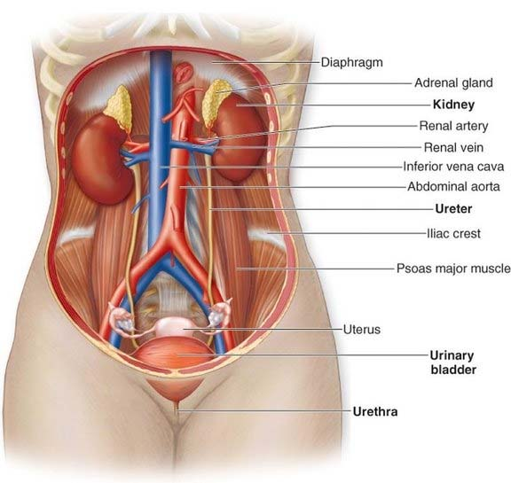
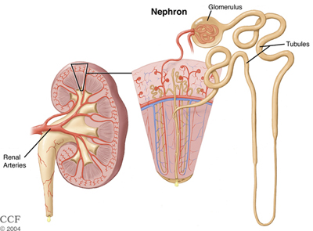
Normal Kidney
The kidneys are a pair of reddish-brown organs located on either side of the spine just below the diaphragm, behind the liver and stomach. They are bean-shaped and about the size of one’s fist.
Notes:
Before we can understand PKD, we have to understand
First the normal kidney and liver
Then the fundamental principles of genetics

Slide 6
How do kidneys help maintain health?
Control blood pressure
Remove wastes (e.g., urea), drugs, and excess fluid through the production of urine
Continuously regulate the body’s fluids and chemical composition (sodium, potassium, phosphorus and calcium)
Produce and release hormones into your blood
erythropoietin - stimulates the bone marrow to make red blood cells
Renin / angiotensin II - regulate blood pressure
calcitriol (a form of Vitamin D) - helps the intestine to absorb calcium from the diet, and thereby maintain healthy bones

Slide 7
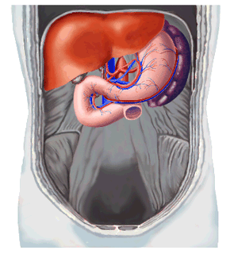
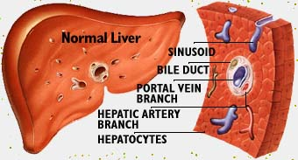
Normal Liver
The liver is one of the largest and most complex organs in the body. It weighs ~1 pound and is made up of a spongy mass of wedge-shaped lobes.
The liver has many functions that are necessary for life:
helps process carbohydrates, fats, and proteins absorbed from food in the intestines and turns them into materials that the body needs for life.
secretes bile to help digest fats.
makes the factors needed for clotting.
stores vitamins.
breaks down toxic substances in the blood.

Slide 8
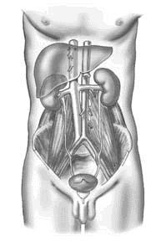
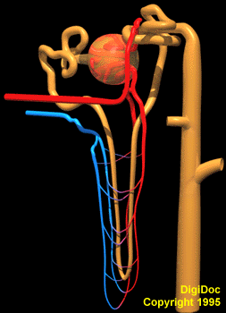
What is polycystic kidney disease (PKD)
Notes:
With this brief primer as a backdrop – now we can tackle PKD
Kidney – disorder primarily affects the tubular structures = nephrons
Liver – the bile duct complexes

Slide 9
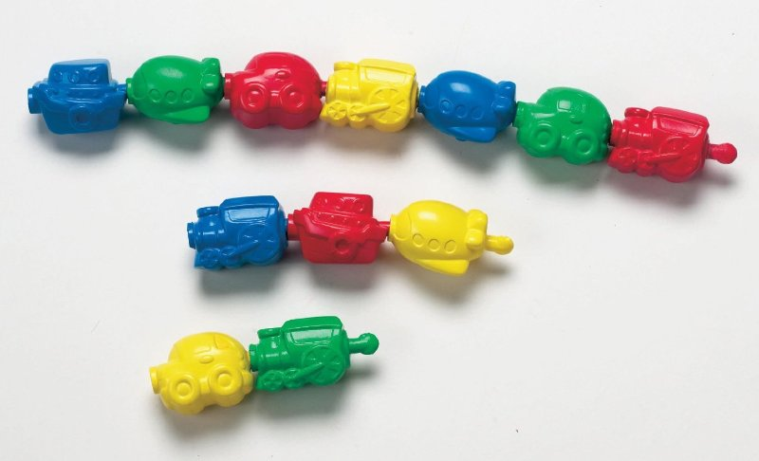
Definitions
Chromosome
Father
Mother
Autosomal dominant PKD (ADPKD)
Affected
Boy
Unaffected
Girl
PKD gene
Normal gene
Chromosome
Father
Mother
Autosomal recessive PKD (ARPKD)
Affected
Boy
Unaffected
Girl
PKD gene
Normal gene
or
Notes:
Turn now to a brief overview of genetics
Humans have 20,000 genes
Organized as paired copies – one from mom/one from dad
Transmitted in entirely random fashion

Slide 10
Lifespan view of polycystic kidney diseases
Notes:
We refer to PKD by the mode of transmission
ADPKD rather than adult PKD
ARPKD rather than infantile PKD

Slide 11
Objectives
The basics of PKD in children
What to do after your child is diagnosed with PKD
Nutritional needs and challenges for children with PKD
Developing a healthcare team for your child
Notes:
I have organized this presentation into 3 parts …..

Slide 12
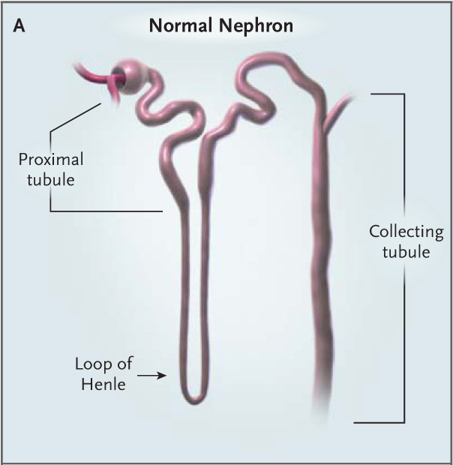
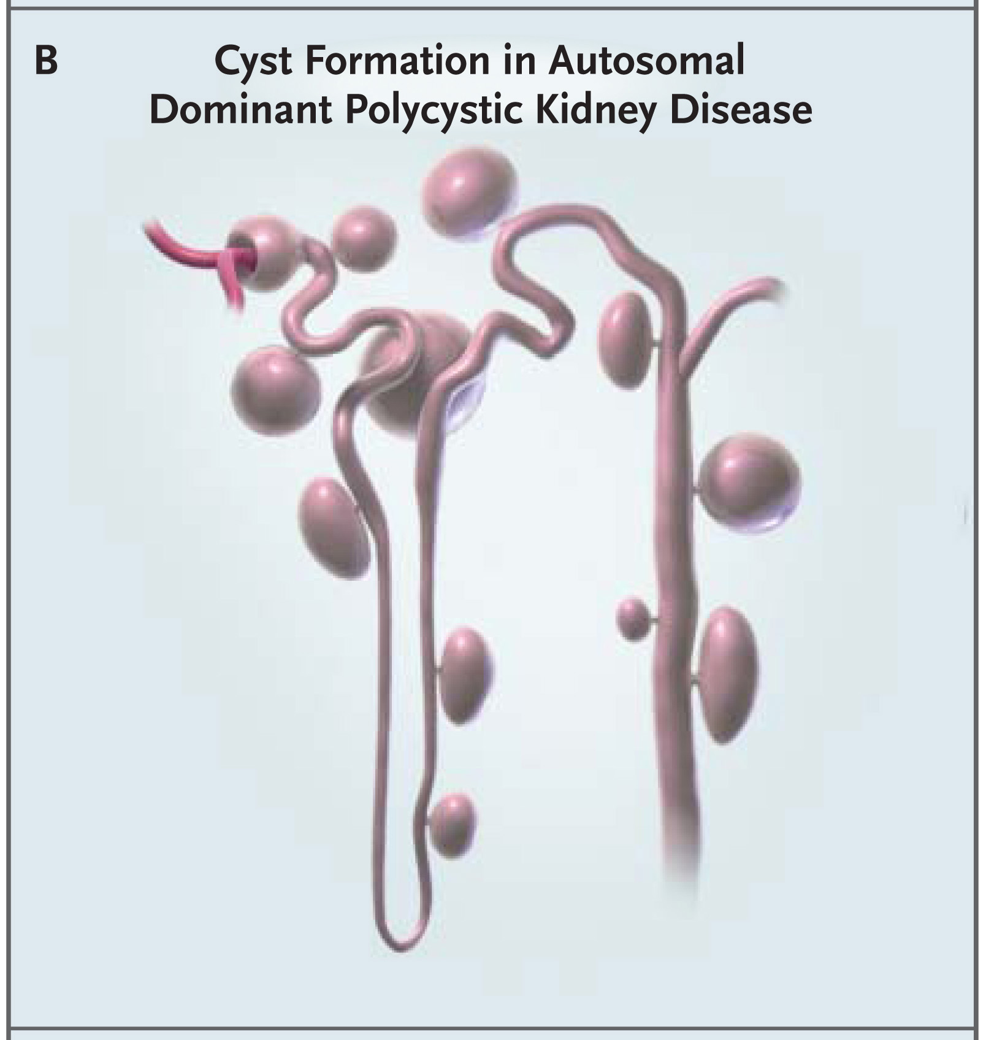
Autosomal Dominant PKD (ADPKD)
Prevalence: 1:800-1,000
Molecular genetics
PKD1: ~80%
PKD2: ~15%
GANAB: <1%
Renal disease
Children and adults
1-2% nephrons affected
normal ➔ very large kidneys
Other associations
biliary cysts, pancreatic cysts
vascular aneurysms, hernias
male infertility
Wilson (2004) N Engl J Med 350:151-64.
Bergmann, C. et al. (2018) Nat. Rev. Dis. Primers
Notes:
PKD1 / PKD2 / GANAB and several other rarer disease genes

Slide 13
ADPKD: Age-related manifestations
 | Early onset | Childhood onset | Adult onset
Mean age of dx | prenatal-1 yr | unknown | 20-40 yrs
One-sided kidney disease | rare | up to 20% | rare
Blood in the urine | unknown | 10% | 35-50%
Protein in the urine | unknown | 30%; 23% | 25%; 17%
High blood pressure | 80% | 22% | 60%
Kidney stones | rare | rare | 20%
End stage kidney disease | 25% | rare | 50%
Biliary cysts (MRI) | rare | 55% | 83%
Mitral valve prolapse | unknown | 12% | 26%
Intracranial aneurysms | rare | rare | 5-7%
Inguinal hernias | unknown | 10% | 3%
Modified from: Fick-Brosnahan et al. (2001) Kidney International; Rizk and Chapman (2008) Pediatric Nephrology.
Notes:
Early onset
Rapidly progressive PKD, up to 25% progress to ESKD by end of adolescence
Childhood PKD
Asymmetry
Proteinuria/hematuria – more common than in adults

Slide 14
ADPKD: Management of kidney issues**
Manifestation | Management
Hypertension | ACEI (or ARB) first line therapy
Abdominal / flank pain | Acute – cyst hemorrhage, infection, stones Chronic – cyst burden
Cyst hemorrhage / gross hematuria | Conservative therapy, resolution 2-7 days
Kidney stones | Hydration and other standard approaches; lithotripsy
Cyst infection | Ciprofloxacin and other quinolones (cyst penetration)
ESKD | Transplantation with native nephrectomy in 20-25% pts
Renal cell cancer | Low index of suspicion; kidney sparing surgery
Monitoring cyst growth | TKV increases exponentially, average 5-6% per year Mayo classification (1A – 1E) (http://www.mayo.edu/research/documents/pkd-center-adpkd-classification/doc-20094754).
**adults
KDIGO Controversies Conference (2015) Kidney Int 88:17-27.
Notes:
These data compiled from adult studies

Slide 15
ADPKD: Management recommendations
International consensus statement on the diagnosis and management of ADPKD in children and young people.
Gimpel et al. (2019) Nature Reviews Nephrology 15:713–726.
Children with a positive family history should be monitored for hypertension (by ambulatory blood pressure monitoring) and albuminuria.
ACE inhibitors are recommended as first line therapy for ADPKD children with hypertension, proteinuria, and hyperfiltration.
ADPKD children should be strongly encouraged to achieve low dietary salt intake, as recommended for all children.

Slide 16
ADPKD: Other considerations
Genetic testing
Affected child
Siblings
Supporting your child
Supporting the family

Slide 17
Autosomal Recessive PKD (ARPKD)
Incidence: 1:26,500
Molecular genetics
PKHD1 (99%)
DZIP1L (<1%)
CYS1 (<1%)
Renal disease
1º collecting ducts
very large kidneys
Other associations
biliary dysgenesis and fibrosis
Bergmann, C. et al. (2018) Nat. Rev. Dis. Primers

Slide 18
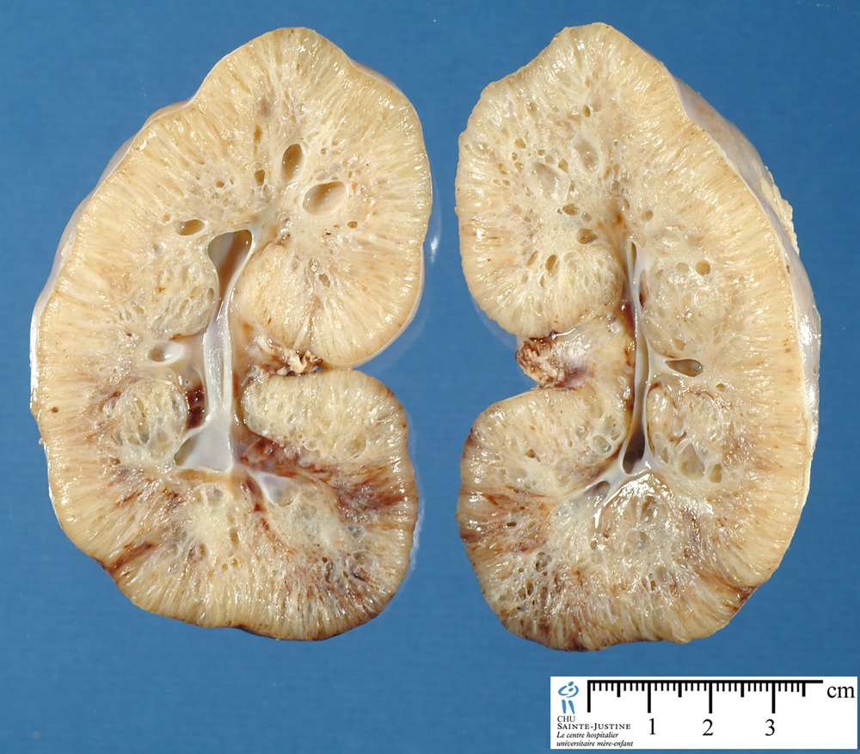
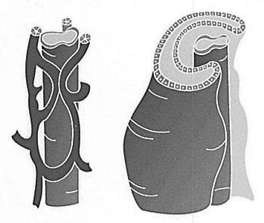
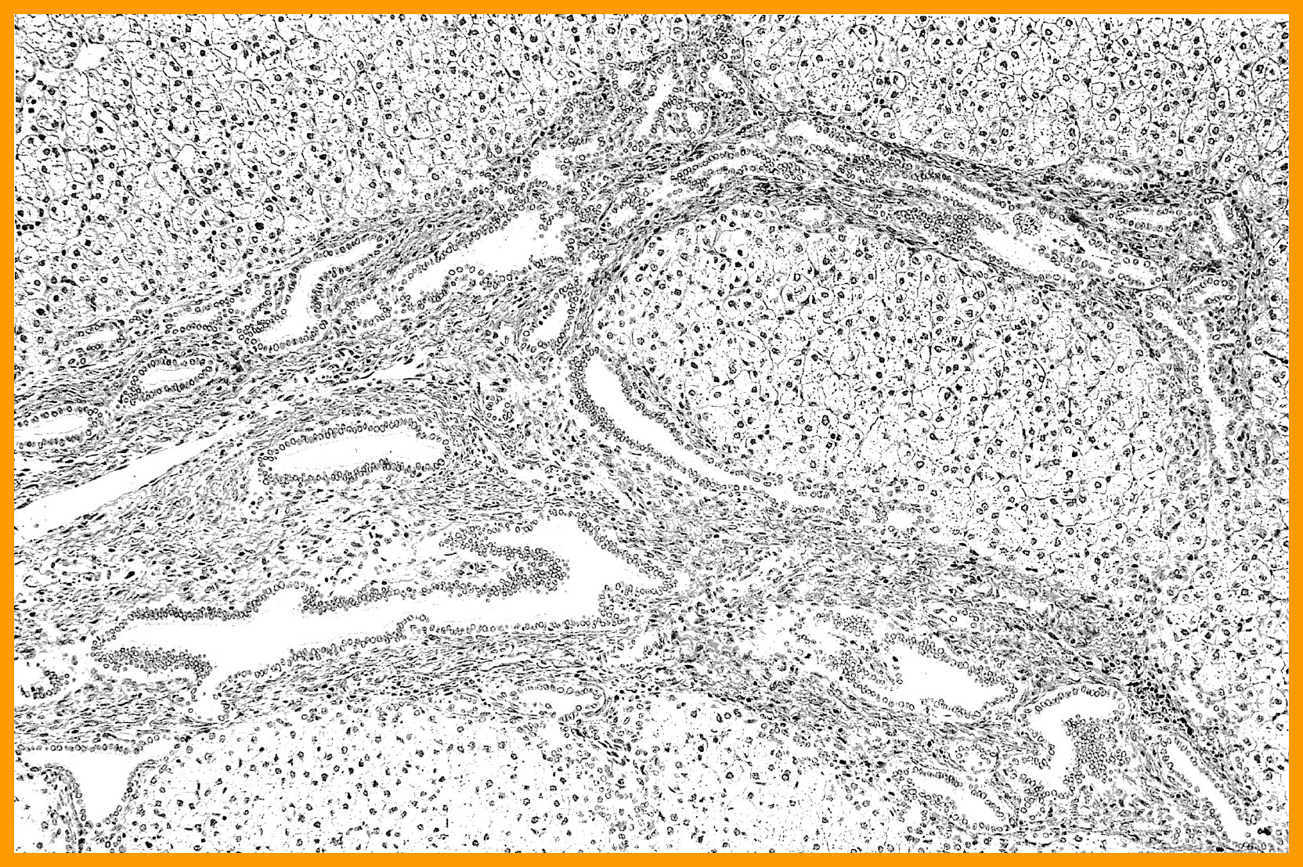
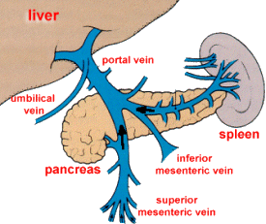
Autosomal Recessive PKD (ARPKD)
KIDNEY
LIVER

Slide 19
ARPKD: Mining the electronic health record
Cerner Health Facts Database
Incidence: 1 in 26,500 live births.
Perinatal mortality: 21%
Prevalence: ~1,500 patients in US
(0-29 yo)
Alzarka et al. (2017) Frontiers in Pediatrics 5:80. eCollection
Notes:
Using EHR to establish
Incidence – how many new babes born per year
Prevalence – how many patients currently alive
Perinatal mortality

Slide 20
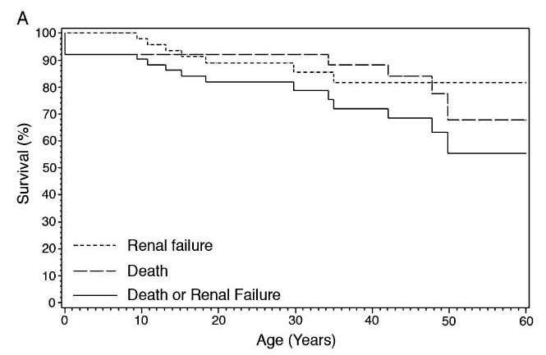
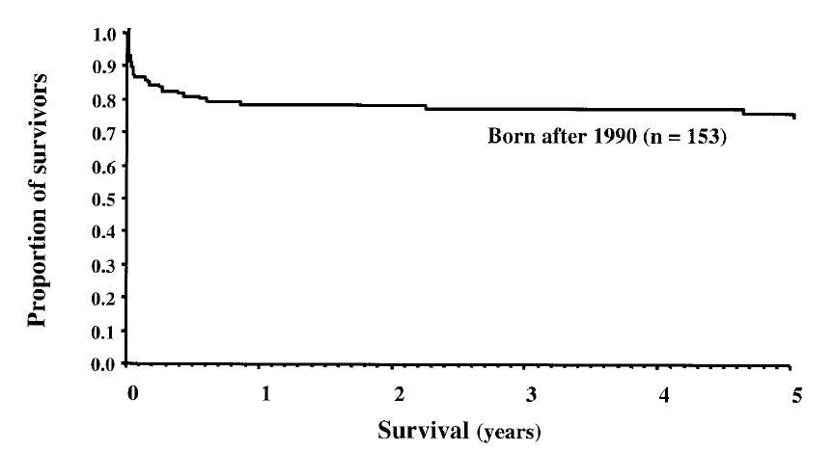
ARPKD: Patient survival
Proportion of survivors
Survival (%)
Age in years
Age in years
Guay-Woodford et al. (2003) Pediatrics 111:1072-1080.
Adeva et al. (2006) Medicine 85:1-21.
Notes:
20

Slide 21
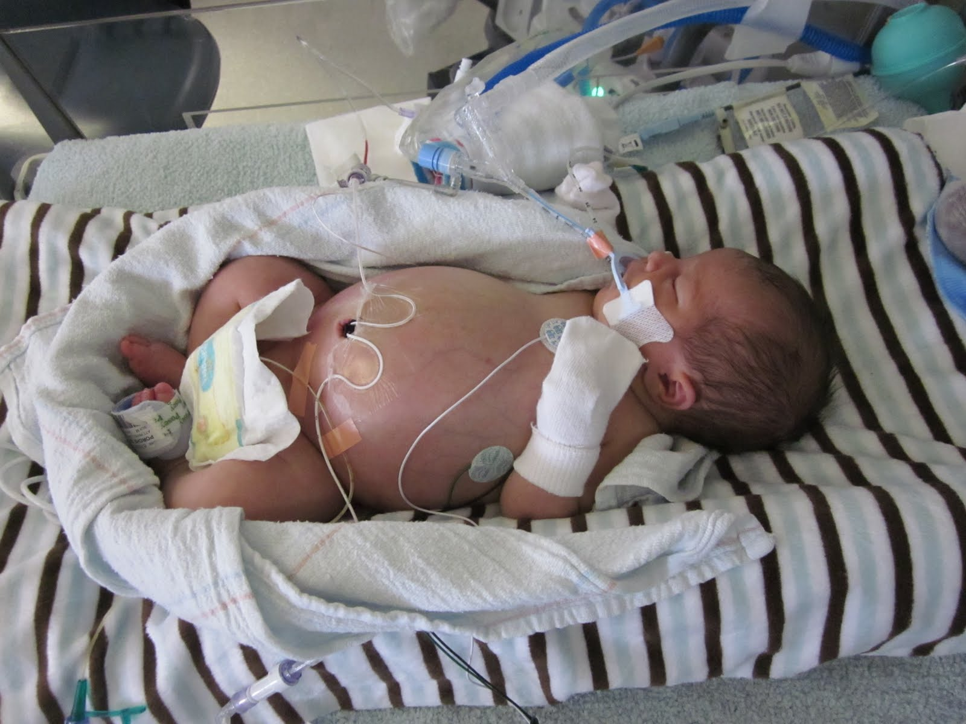
ARPKD: Clinical features in newborns
INCIDENCE: 1:26,500 live births
Typical birth at 34-36 wks gestation
RESPIRATORY
Poor lung development
21% mortality
KIDNEY
Hyponatremia
Decreased kidney function
Very enlarged kidneys
Hypertension
Guay-Woodford et al. (2014) J Pediatr. 165:611-617

Slide 22
ARPKD: Clinical features in infants and children
INCIDENCE: 1:26,500 live births
Typical birth at 34-36-wks gestation
RESPIRATORY
Poor lung development
21% mortality
Chronic lung disease
LIVER
Portal hypertension
Variceal bleeding
Cholangitis
INTRACRANIAL ANEURYSMS
KIDNEY
Electrolyte abnormalities
Hypertension
Declining kidney function
FEEDING ISSUES
Poor growth
Guay-Woodford et al. (2014) J Pediatr. 165:611-617.
© 2019 CTSI-CN | CLINICAL AND TRANSLATIONAL SCIENCE INSTITUTE AT CHILDREN'S NATIONAL | CTSICN.ORG

Slide 23
ARPKD: Clinical management considerations
 | No. Am. Database (2003) (N=166) | Bergmann (2005) (N=164)
Prenatal diagnosis | 46% | 23%
Hyponatremia (low sodium) | 26% | Not reported
Hypertension (high blood pressure) | 65% | 76%
Urinary tract infection | 25% | Not reported
Chronic kidney disease | 42% | 86%
End stage kidney disease | 13% | 29%
Growth issues | 24% | 16%
Chronic lung disease | 12% | Not reported
Portal hypertension (due to liver disease) | 15% | 44%
1-yr survival | 92% | 85%

Slide 24
ARPKD: Other considerations
Genetic testing
Affected child
Siblings
Supporting your child
Supporting the family

Slide 25
PKD: Considering research participation for your child
Advancing knowledge | Status in 2023
Research-ready patient cohorts | Databases: ARPKD: US/European ADPKD: Global
Biomarkers of disease progression | Clinical, biochemical, genetic, imaging
Therapeutics | Clinical trials: drug-repurposing; novel agents Common pathways (PKD) Specific pathways (ARPKD)

Slide 26
Objectives
The basics of PKD in children
What to do after your child is diagnosed with PKD
Nutritional needs and challenges for children with PKD
Developing a healthcare team for your child
Notes:
I have organized this presentation into 3 parts …..

Slide 27
PKD: Nutrition considerations for children
Limited research in children (ARPKD)
Data from ADPKD adults
What makes cysts grow faster?
Eating a high amount of:
Dietary Acids – high animal protein / low fruits and vegetables
Sodium
Drinking a low amount of water
Notes:
Now let’s get more specific

Slide 28
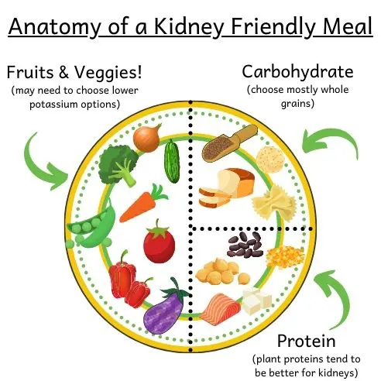
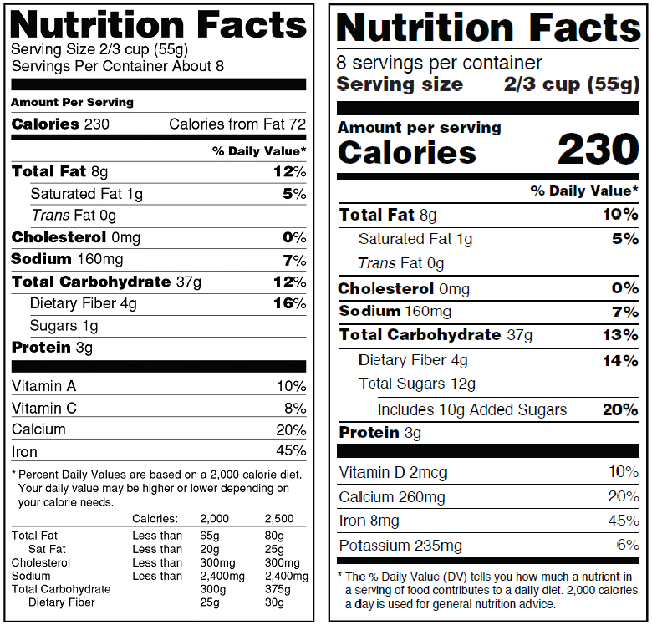
PKD: Nutrition considerations for the family
Source: https://www.thekidneydietician.org/renal-fdiet-grocery-list/
Notes:
Now let’s get more specific

Slide 29
PKD: Nutrition considerations for children
0-1 yo | 1-3 yo | 4-5 yo | 6-12 yo | 13-18 yo | >18 yo
Possible use of specialized formulas in the future Baby foods | Critical time to offer variety of foods Encourage fluids during day Offer fruits & vegetables at every meal Limit processed foods | School age children – peer influence School lunch send meals from home cafeteria –select meals together | Water vs. sports drinks Have a bottle in class Fast food Fresh, unsalted fries | School lunch Sports coaches Limit meat to meals | College years Limited kitchen access Energy drinks Alcohol
Vitamins from food rather than supplements Don’t restrict food unless a doctor recommends it
Notes:
Now let’s get more specific

Slide 30
Objectives
The basics of PKD in children
What to do after your child is diagnosed with PKD
Nutritional needs and challenges for children with PKD
Developing a healthcare team for your child
Notes:
I have organized this presentation into 3 parts …..

Slide 31
PKD Clinical management: Multidisciplinary team
Nephrology (kidneys)
Kidney function
Blood pressure
Psychology
Hepatology (liver)
Congenital hepatic fibrosis (CHF)
06
02
03
Nutrition
Endocrinology (growth)
Genetics
Notes:
© Copyright PresentationGO.com – The free PowerPoint and Google Slides template library

Slide 32
Summary
PKD is a clinically significant disorder in children.
While the polycystic kidney diseases are clinically distinct, many disease manifestations are common.
Current therapy focuses on supportive management.
Clinical trial design for targeted therapeutics has been hampered by the lack of prognostic and predictive markers.
Research-ready cohorts are changing the landscape.

Slide 33
Contact information
Lisa M. Guay-Woodford, MD Children’s Hospital of Philadelphia
E-Mail: guaywoodfl@chop.edu
Inherited Kidney Disorders (IKD) Program
Children’s Hospital of Philadelphia
Lisa M. Guay-Woodford, MD
Erum Hartung
Inherited and Polycystic Kidney Disorders (IPKD) Program
Children’s National Hospital (Washington DC)
Ashima Gulati, MD, PhD

